Slide 1
组会分享
2021-03-15

Slide 2
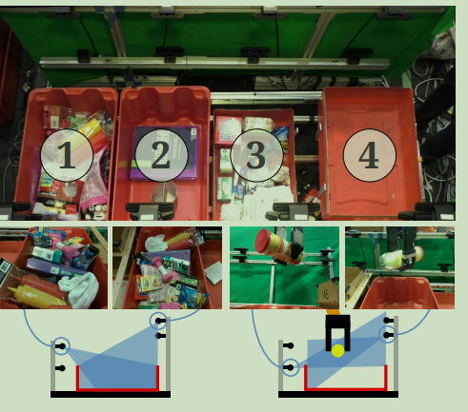
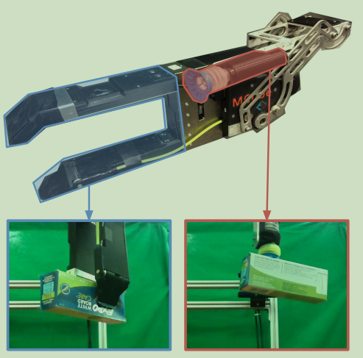
Robotic Pick-and-Place of Novel Objects in Clutter with Multi-Affordance Grasping and Cross-Domain Image Matching
MIT-Princeton Team system that took 1st place in the stowing task at the 2017 Amazon Robotics Challenge.

Slide 3
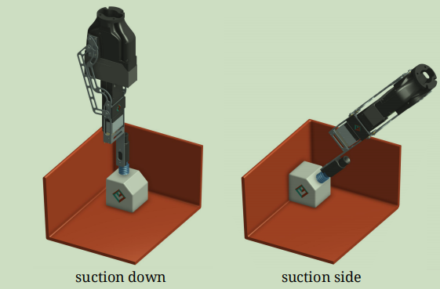
Robotic Pick-and-Place of Novel Objects in Clutter with Multi-Affordance Grasping and Cross-Domain Image Matching
抓取的方案：既有夹具又有吸盘
吸盘部分：仅做两个动作的区分。

Slide 4
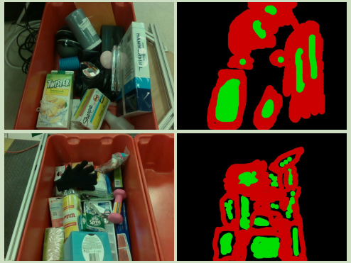
Robotic Pick-and-Place of Novel Objects in Clutter with Multi-Affordance Grasping and Cross-Domain Image Matching
数据集
提供了图片数量为1800+的数据集
数据集中是像素级的分类标签：分为可以吸取、不可吸取、未标注三类。

Slide 5
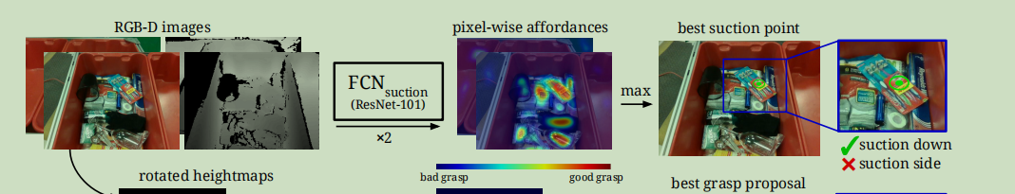
Robotic Pick-and-Place of Novel Objects in Clutter with Multi-Affordance Grasping and Cross-Domain Image Matching
网络
预训练的Resnet101作为主干，加入上采样将输出尺寸恢复成输入尺寸。

Slide 6
Robotic Pick-and-Place of Novel Objects in Clutter with Multi-Affordance Grasping and Cross-Domain Image Matching
从affordances中求出需要抓取的位置
先从网络得到affordances，然后将affordances中值最大的位置的法向量求出来，然后再根据该位置的表面法向量确定是从上往下吸取还是从侧面吸取

Slide 7
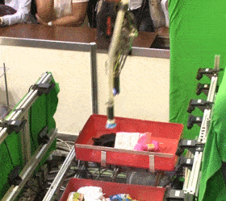
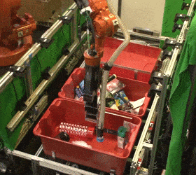
Robotic Pick-and-Place of Novel Objects in Clutter with Multi-Affordance Grasping and Cross-Domain Image Matching
https://vision.princeton.edu/projects/2017/arc/

Slide 8
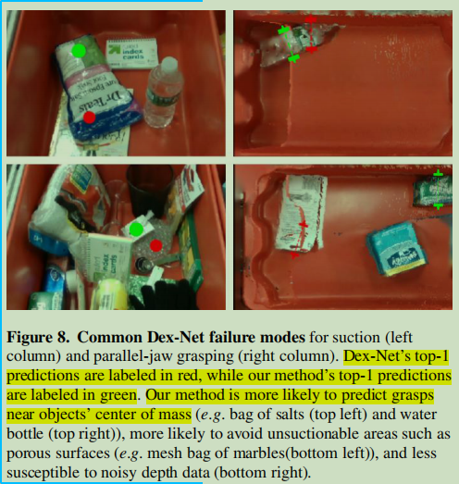
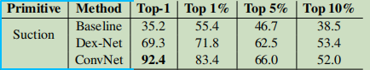
Robotic Pick-and-Place of Novel Objects in Clutter with Multi-Affordance Grasping and Cross-Domain Image Matching
论文实验结果

Slide 9
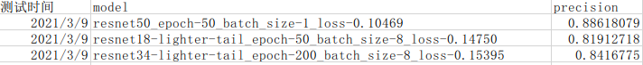
Robotic Pick-and-Place of Novel Objects in Clutter with Multi-Affordance Grasping and Cross-Domain Image Matching
复现情况
用了三个不同的resnet主干网络

Slide 10
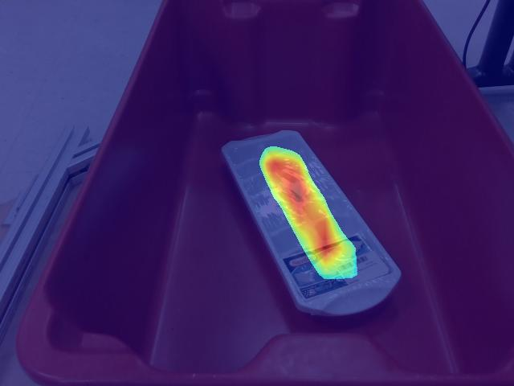
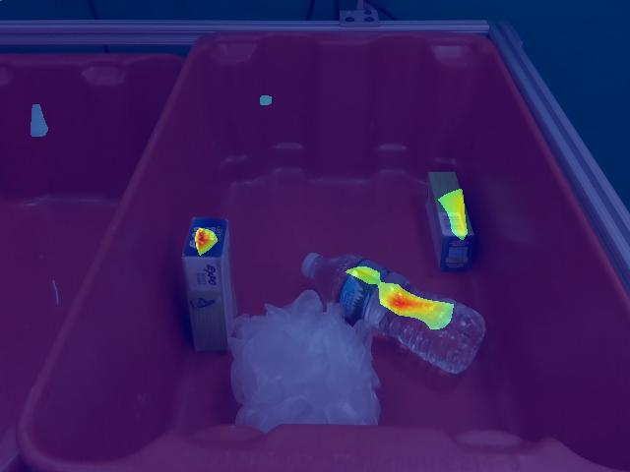
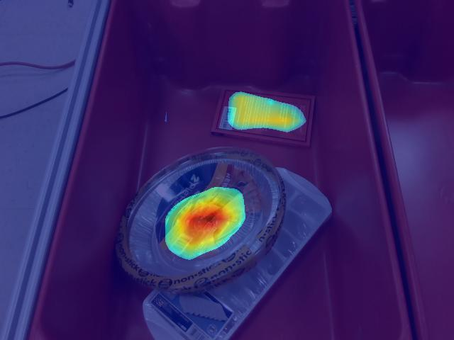
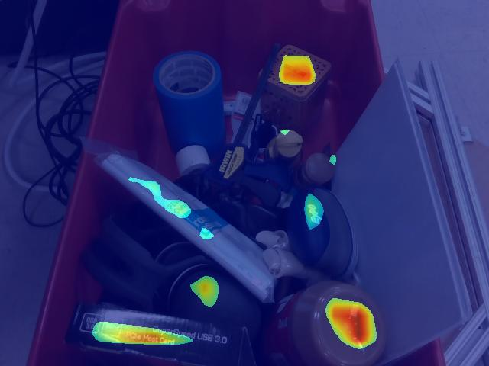
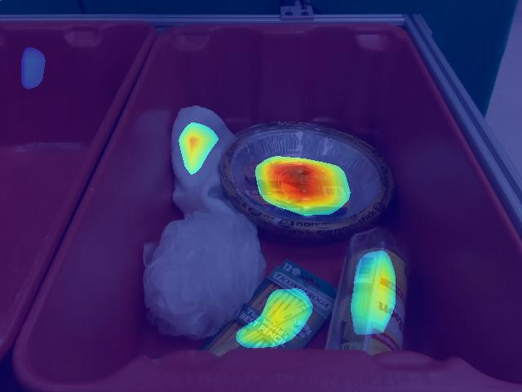
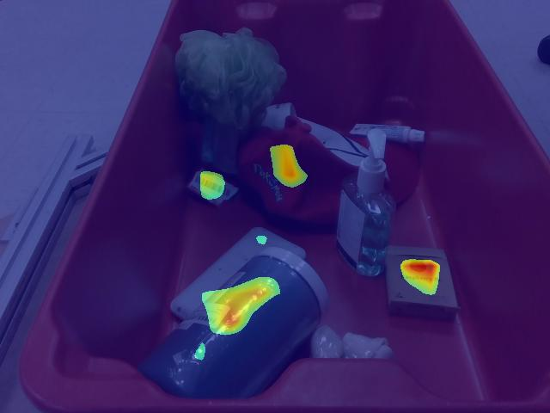
Robotic Pick-and-Place of Novel Objects in Clutter with Multi-Affordance Grasping and Cross-Domain Image Matching
主干resnet50

Slide 11
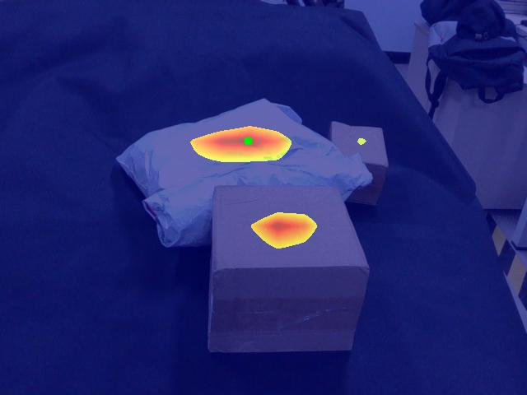
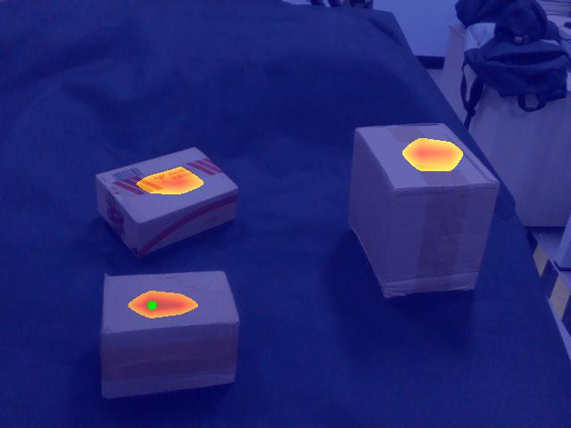
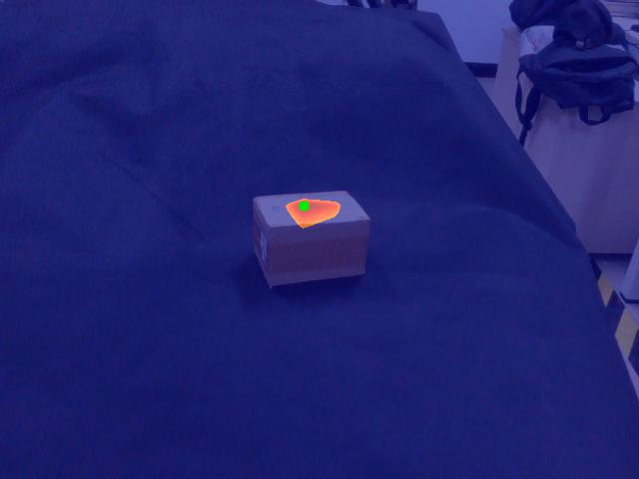
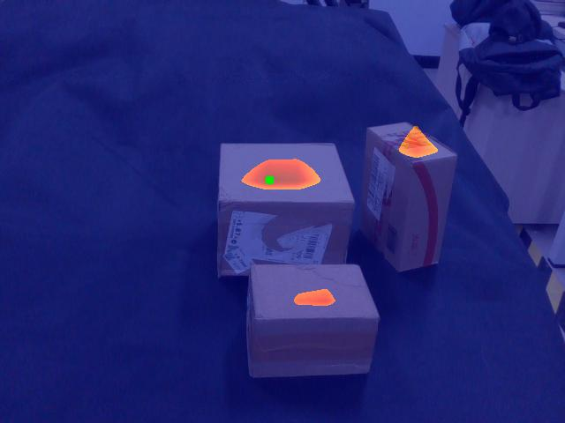
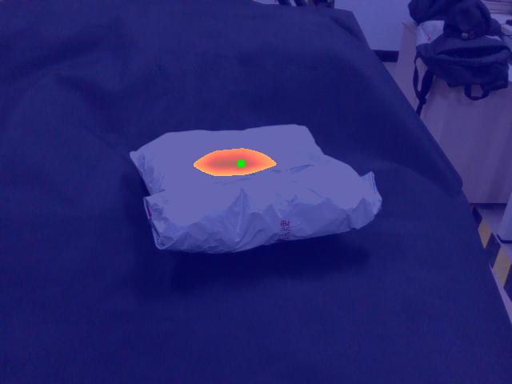
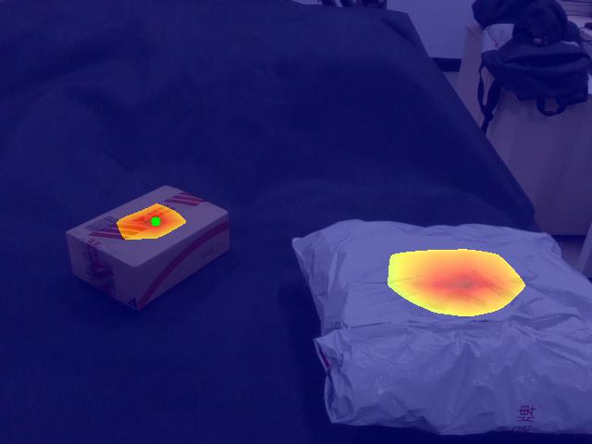
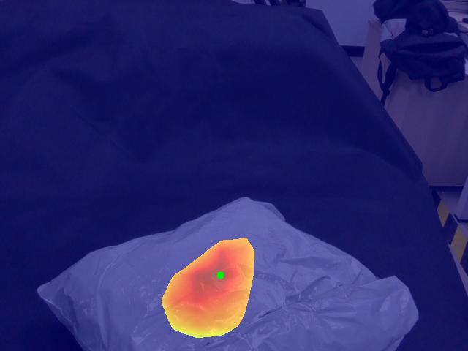
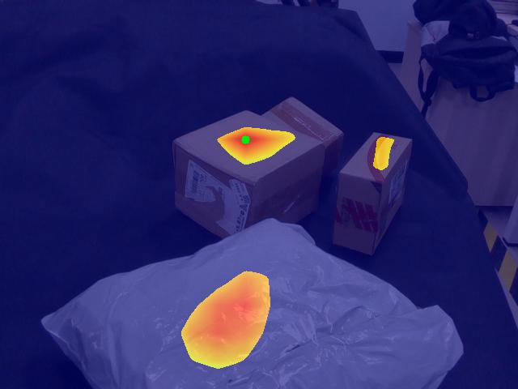
Robotic Pick-and-Place of Novel Objects in Clutter with Multi-Affordance Grasping and Cross-Domain Image Matching
真实场景

Slide 12
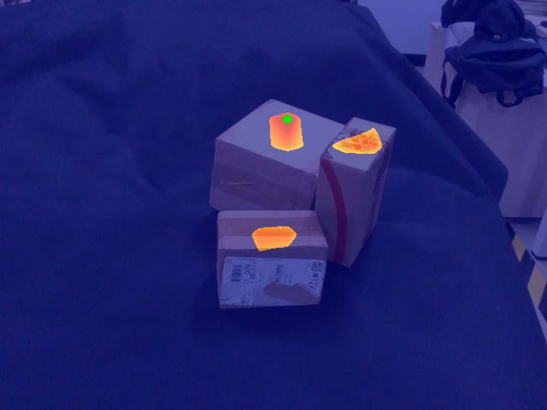
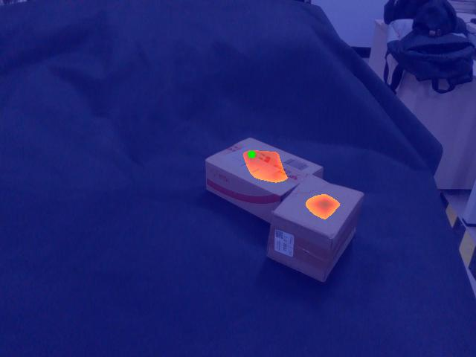
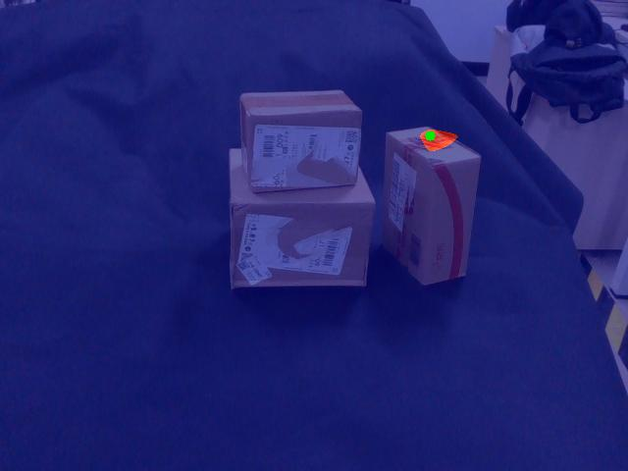
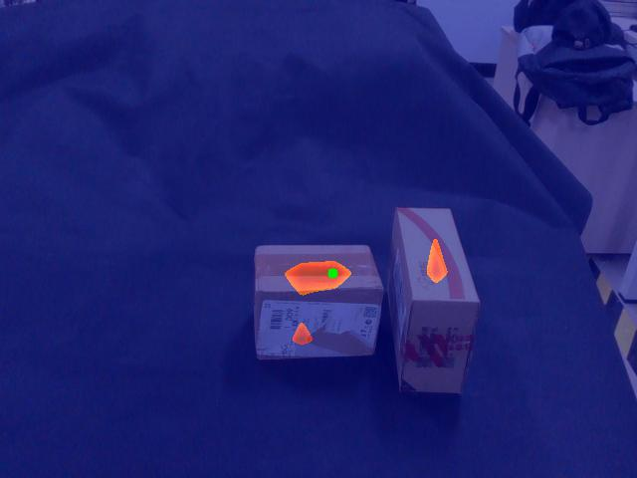
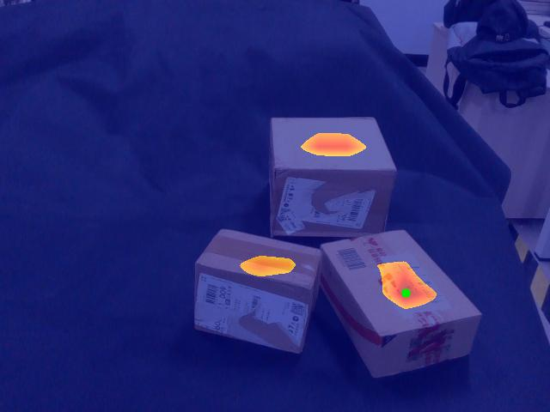
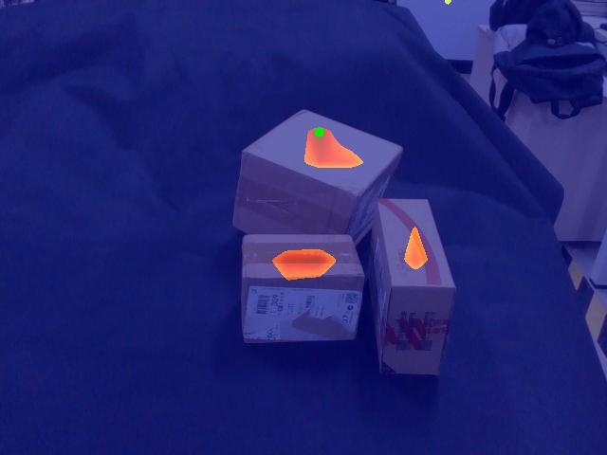
场景

Slide 13

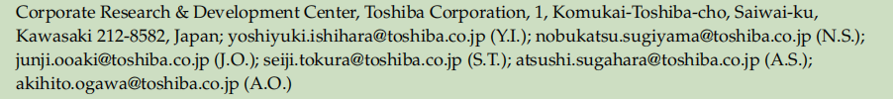
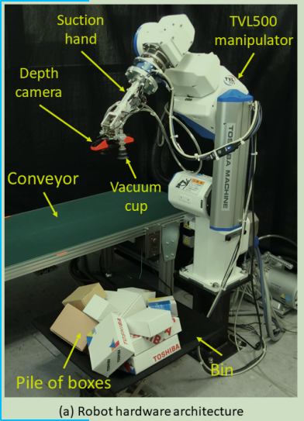
Depth Image–Based Deep Learning of Grasp Planning for Textureless Planar-Faced Objects in Vision-Guided Robotic Bin-Picking
对象：无纹理的、表面规整的物体。论文的场景是堆叠的纸盒。
仅用深度图
执行器是双吸盘
通过网络判断哪一个吸盘动作
并且判断从一堆物体中，先对哪个物体进行动作

Slide 14
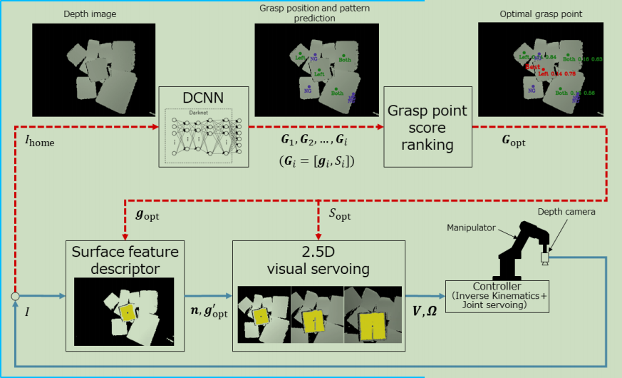
Depth Image–Based Deep Learning of Grasp Planning for Textureless Planar-Faced Objects in Vision-Guided Robotic Bin-Picking

Slide 15
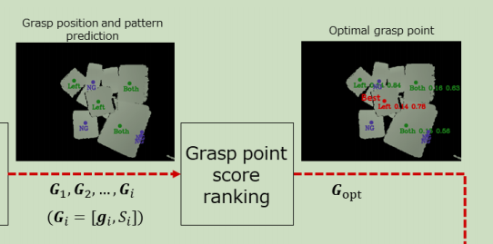
Depth Image–Based Deep Learning of Grasp Planning for Textureless Planar-Faced Objects in Vision-Guided Robotic Bin-Picking
从网络预测得到的抓取位置，为每个抓取点打分；得分越高的点应该优先抓取
具体打分的原则是：
考虑抓取点和指定原点的距离；
考虑抓取点的法向量和相机z轴之间的夹角。

Slide 16
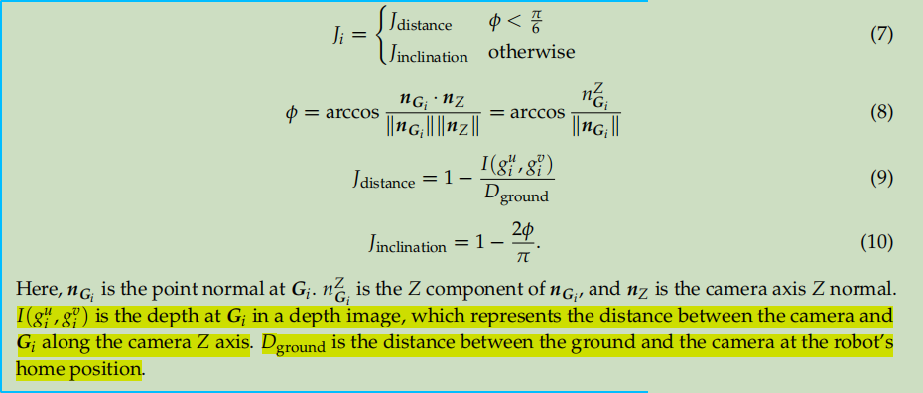
Depth Image–Based Deep Learning of Grasp Planning for Textureless Planar-Faced Objects in Vision-Guided Robotic Bin-Picking

Slide 17
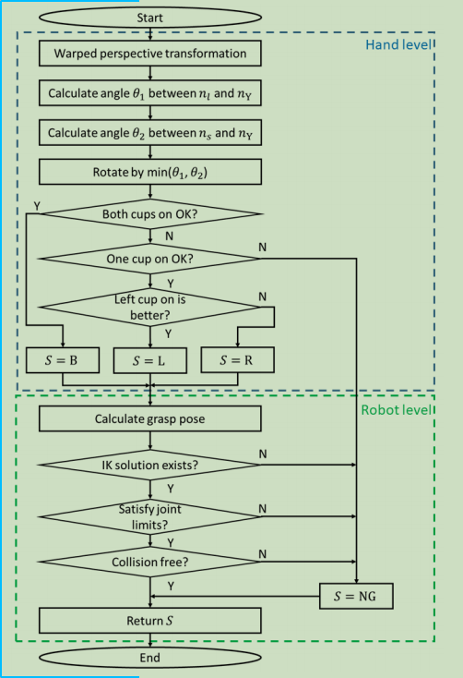
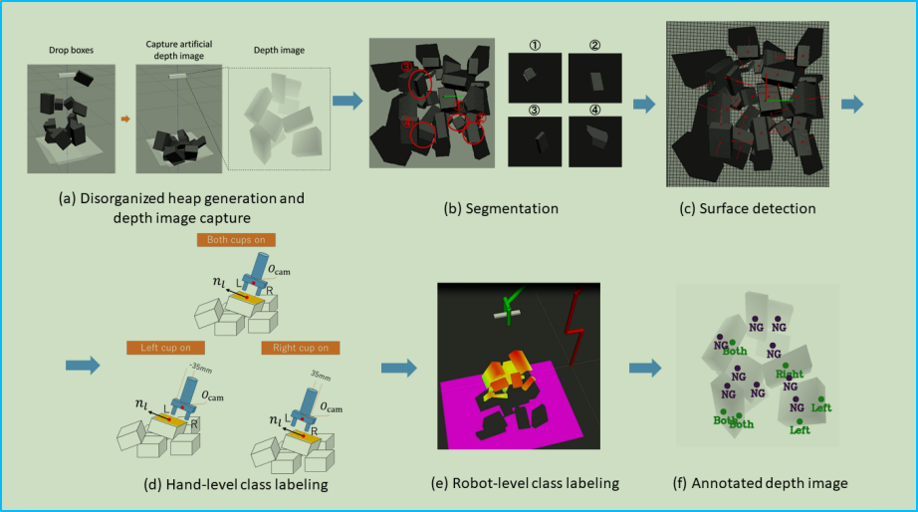
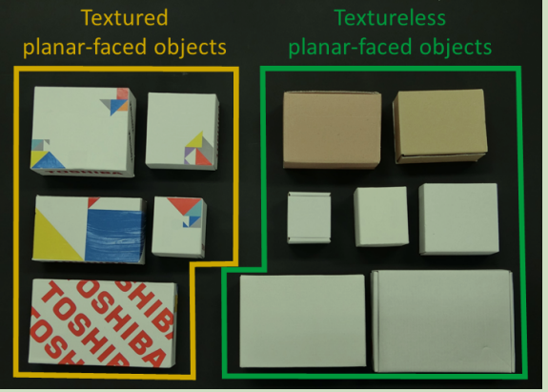
Depth Image–Based Deep Learning of Grasp Planning for Textureless Planar-Faced Objects in Vision-Guided Robotic Bin-Picking
数据集：使用全合成数据集训练，再真实物体上验证和测试
可见表面的中点作为抓取点

Slide 18
讨论
数据集采集
执行器吸盘

Slide 19
